Slide 1
TAG goes to Boston
Wednesday, October 24 – Saturday, October 27, 2018
4 days, 3 nights in Boston

Slide 2
Day 1

Slide 3
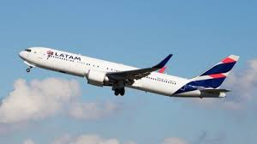
Bringing learning to life!
Notes:
We will travel to Boston round trip via air from MSY out of the New Orleans Airport.

Slide 4
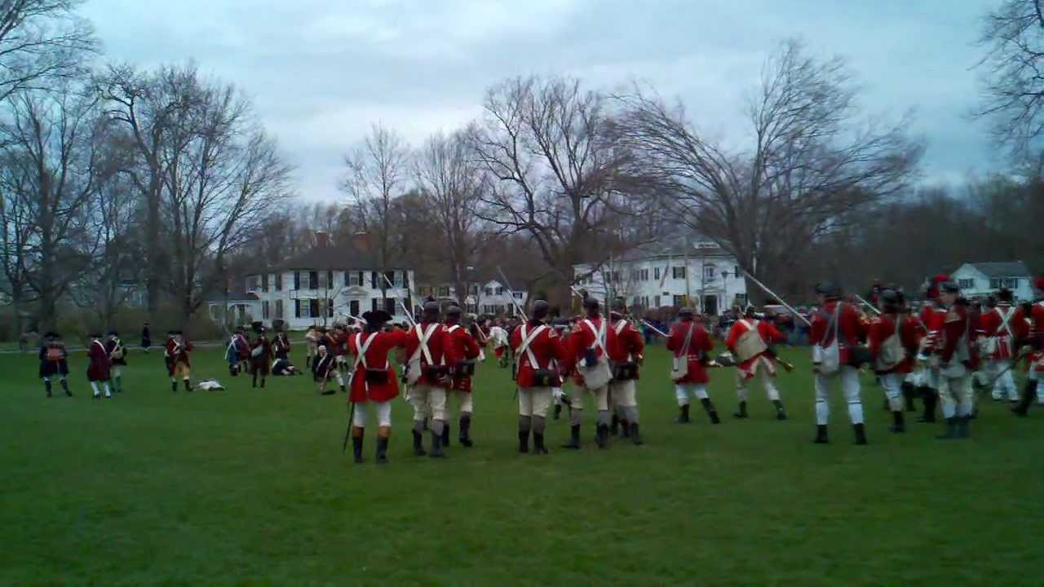
Lexington Battle Green
Notes:
We will visit Lexinton Battle Green. It was at this site that the opening shots of the Battles of Lexington and Concord were fired on April 19, 1775, starting the American Revolutionary War.

Slide 5
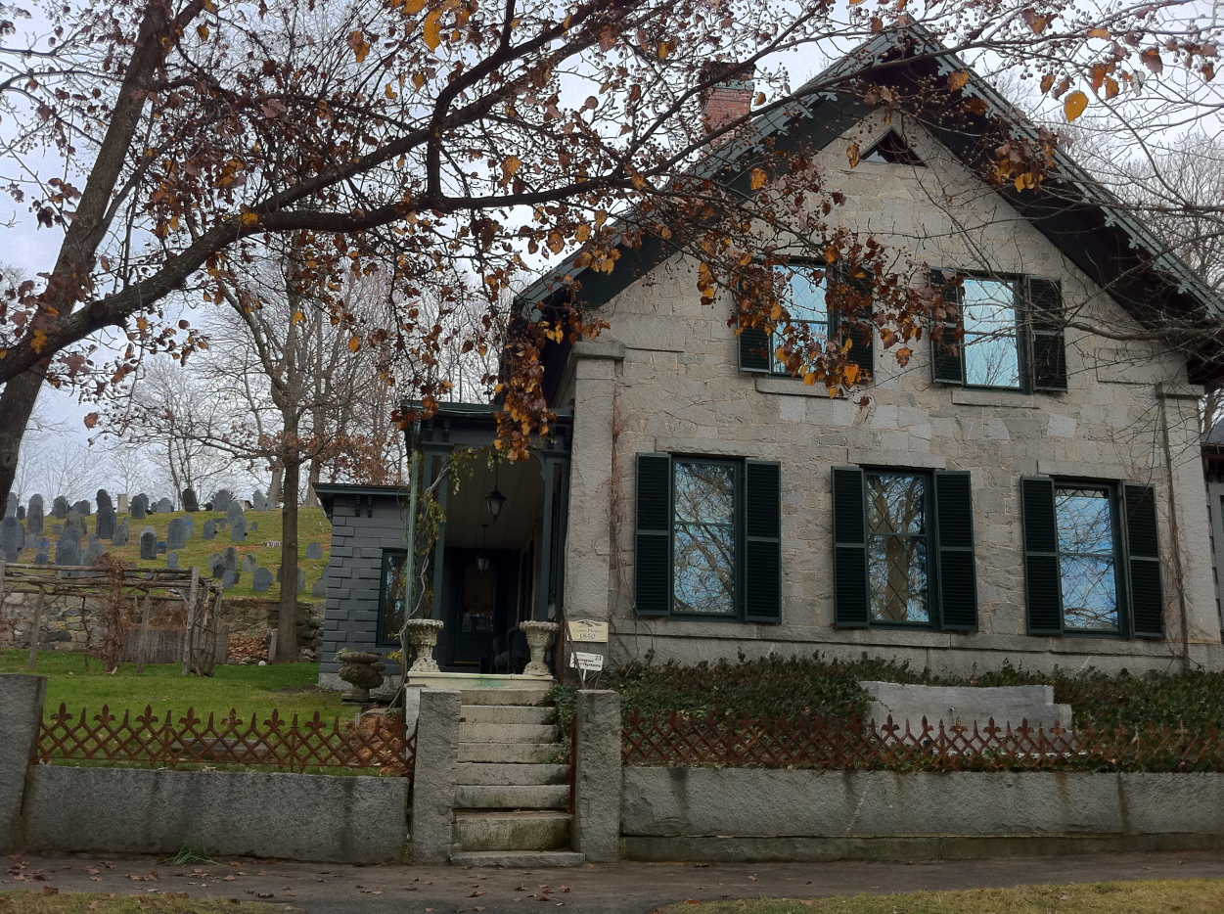
Concord
Notes:
We will visit Concord which was a remarkably rich literary center during the mid-nineteenth century. Featured were Ralph Waldo Emerson, Nathaniel Hawthorne, Amos Bronson Alcott, Louisa May Alcott and Henry David Thoreau, all of whose homes are preserved in modern-day Concord. The now-ubiquitous Concord grape was developed here.

Slide 6
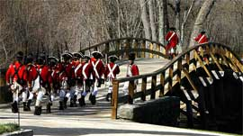
Old North Bridge
Notes:
We will visit The Old North Bridge. The Old North Bridge in Concord, Massachusetts, was the site of the first real skirmish of the American Revolution.

Slide 7
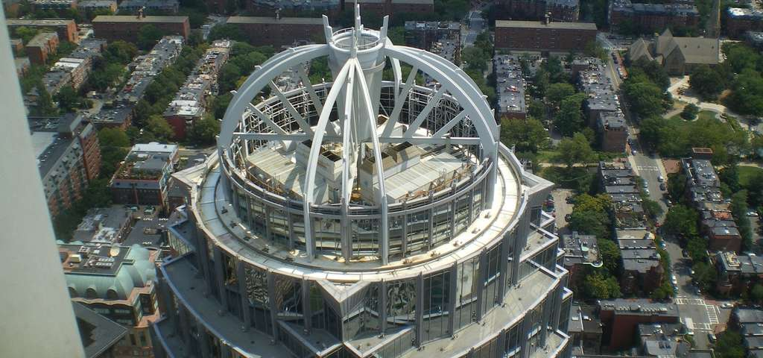
Prudential Center-Skywalk Observatory
Notes:
We will then visit the Skywalk Observatory, Boston's only sky-high vantage point for sweeping 360 degree views of Greater Boston and beyond.

Slide 8
Day 2

Slide 9
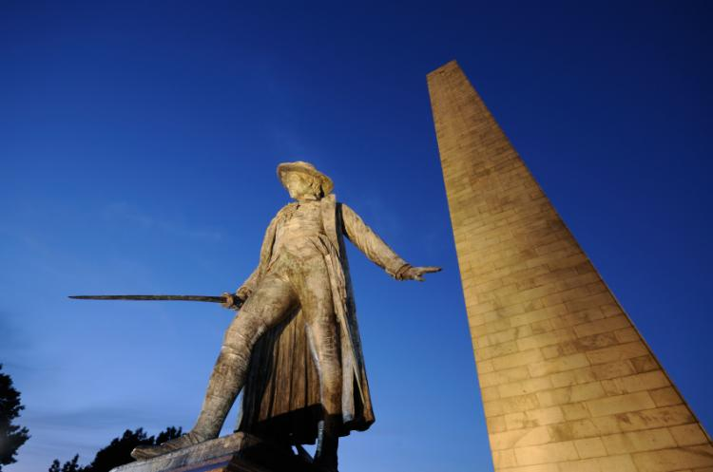
Bunker Hill
Notes:
On June 17, 1775, early in the Revolutionary War (1775-83), the British defeated the Americans at the Battle of Bunker Hill in Massachusetts. Despite losing their strategic positions, the battle was a significant morale-builder for the inexperienced Americans, convincing them that patriotic dedication could overcome superior British military might. Additionally, the high price of victory at the Battle of Bunker Hill made the British realize that the war with the colonies would be long, tough and costly.

Slide 10
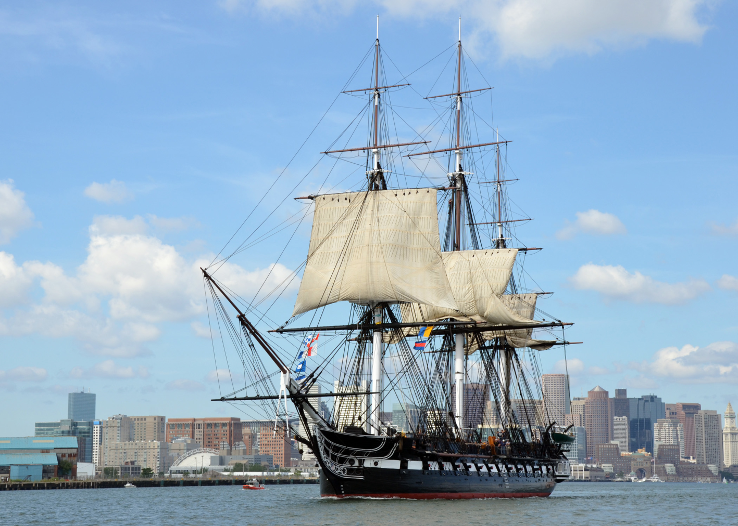
U.S.S. Constitution
Notes:
We will visit the USS Constitution is a wooden-hulled, three-masted heavy frigate of the United States Navy, named by President George Washington after the Constitution of the United States of America. She is the world's oldest commissioned naval vessel afloat.

Slide 11
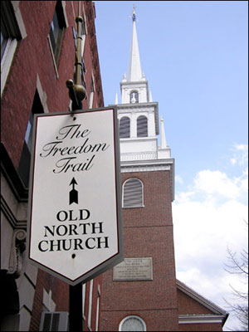
Old North Church
Notes:
The nest stop along The Freedom Trail will be the Old North Church, Boston’s oldest surviving church building.

Slide 12
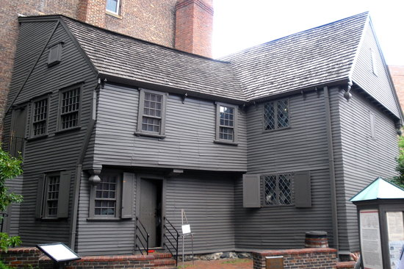
Paul Revere House
Notes:
Then we will visit the Paul Revere House (1680) which was the colonial home of American patriot Paul Revere during the time of the American Revolution.

Slide 13
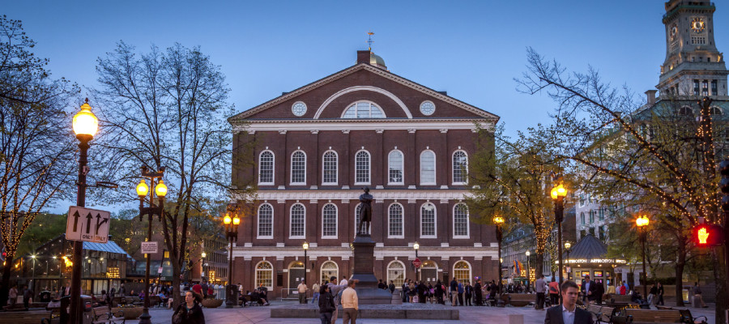
Faneuil Hall
Notes:
We will visit Faneuil Hall. It has been a marketplace and a meeting hall since 1743. It was the site of several speeches by Samuel Adams, James Otis, and others encouraging independence from Great Britain. Now it is part of Boston National Historical Park and a well-known stop on the Freedom Trail. It is sometimes referred to as "the Cradle of Liberty".

Slide 14
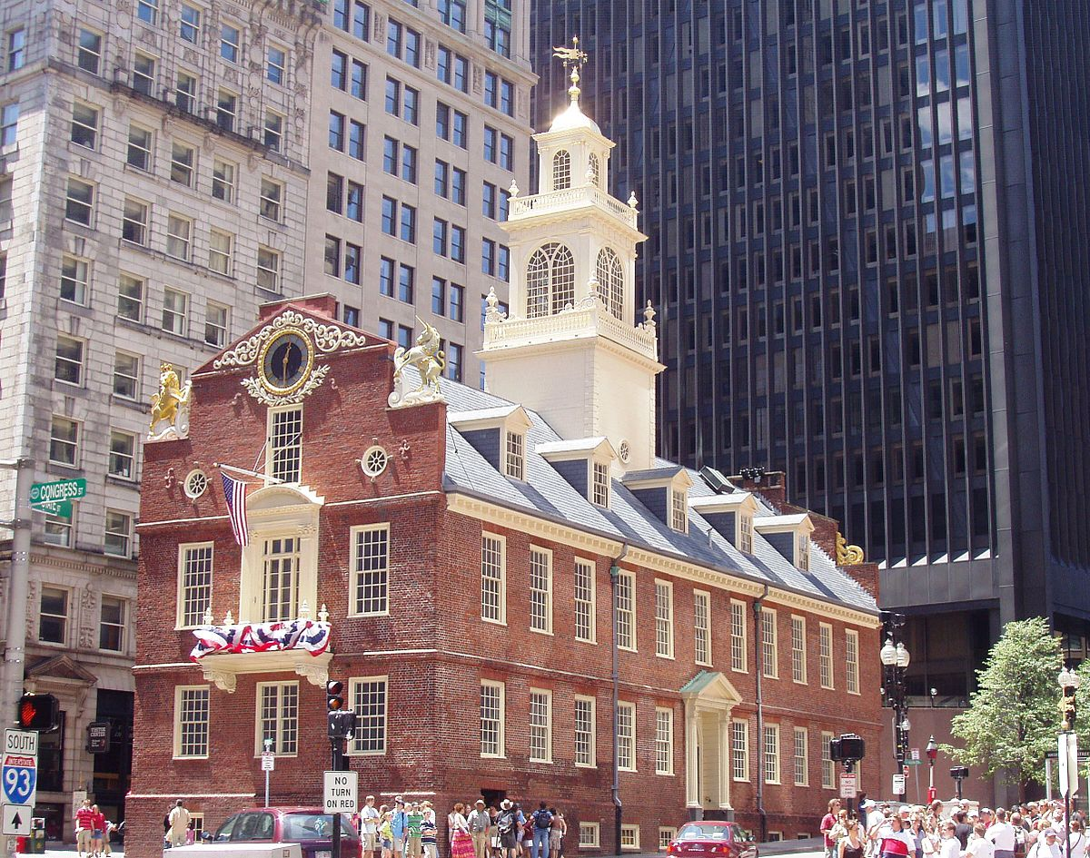
Old State House
Notes:
The Freedom Trail will also lead us to the Old State House. Built in 1713, it was the seat of the Massachusetts General Court until 1798, and is one of the oldest public buildings in the United States.

Slide 15
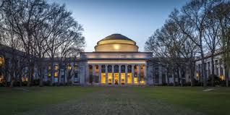
Massachusetts Institute of Technology
Notes:
The students will have the opportunity to participate in hands on STEAM activities at the prestigious MIT!

Slide 16
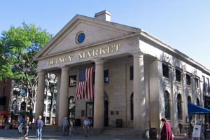
Quincy Market
Notes:
We will have time to shop also at Quincy Market.

Slide 17
Day 3

Slide 18
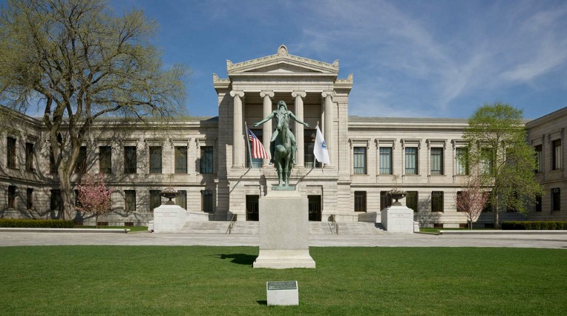
Boston Museum of Fine Arts
Notes:
We will get to visit the fourth largest museum in the United States. It contains more than 450,000 works of art, making it one of the most comprehensive collections in the Americas.

Slide 19
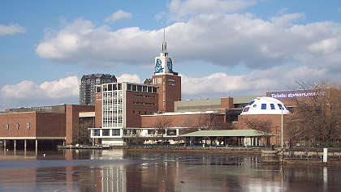
Museum of Science
Notes:
While we are visiting museums, we will include the Boston Museum of Science. over 700 interactive exhibits, the museum features a number of live presentations throughout the building every day, along with shows at the Charles Hayden Planetarium and the Mugar Omni Theater, the only domed IMAX screen in New England. The museum is also an accredited member of the Association of Zoos and Aquariums (AZA) and is home to over 100 animals, many of which have been rescued and rehabilitated from various dangerous situations.

Slide 20
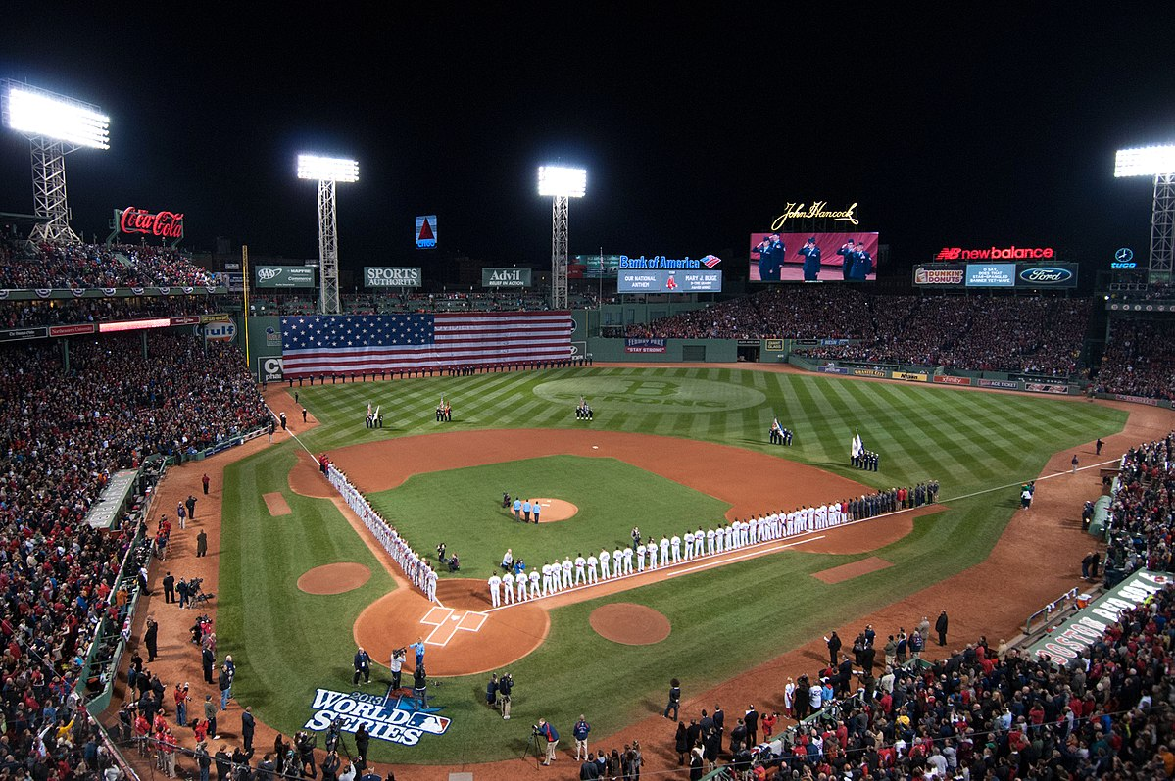
Fenway Park
Notes:
Our trip will also include a tour of Fenway park. Since 1912, it has been the home for the Boston Red Sox, the city's American League baseball team, and since 1953, its only Major League Baseball (MLB) franchise. It is the oldest ballpark in MLB.

Slide 21
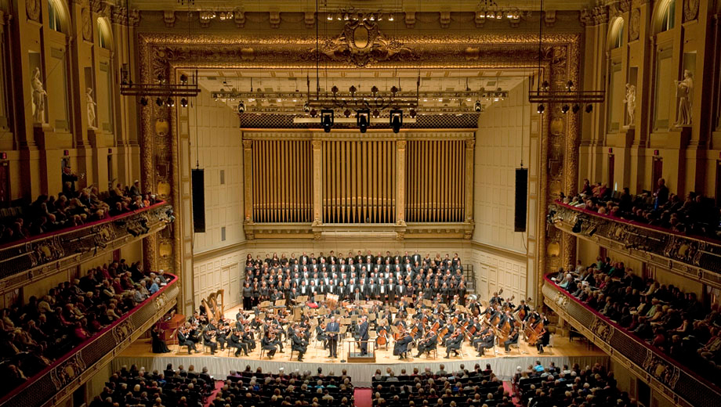
Boston Symphony Orchestra Tour
Notes:
The Boston Symphony Orchestra (BSO) is an American orchestra based in Boston, Massachusetts. It is one of the five major American symphony orchestras. The Orchestra performs in a stately 1900 concert hall. The students will be able to go behind the scenes of this beautiful hall!

Slide 22
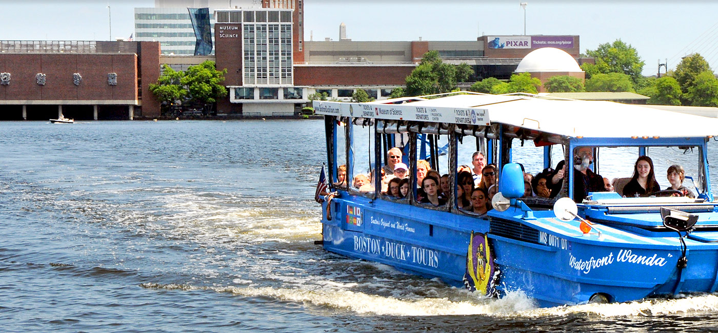
Duck Tour
Notes:
We will experience Boston's Most Popular Tour with the famous Boston Duck Tours. This tour of Boston includes land & water!

Slide 23
Day 4

Slide 24
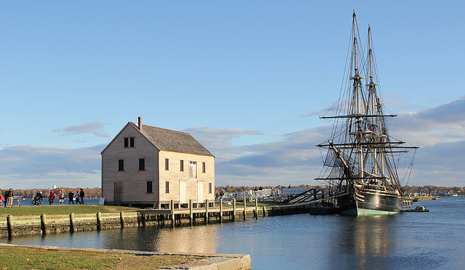
Salem Tour
Notes:
We will tour Salem Maritime National, Historic Park and Custom House. We will learn the truth behind the stories of Salem.

Slide 25
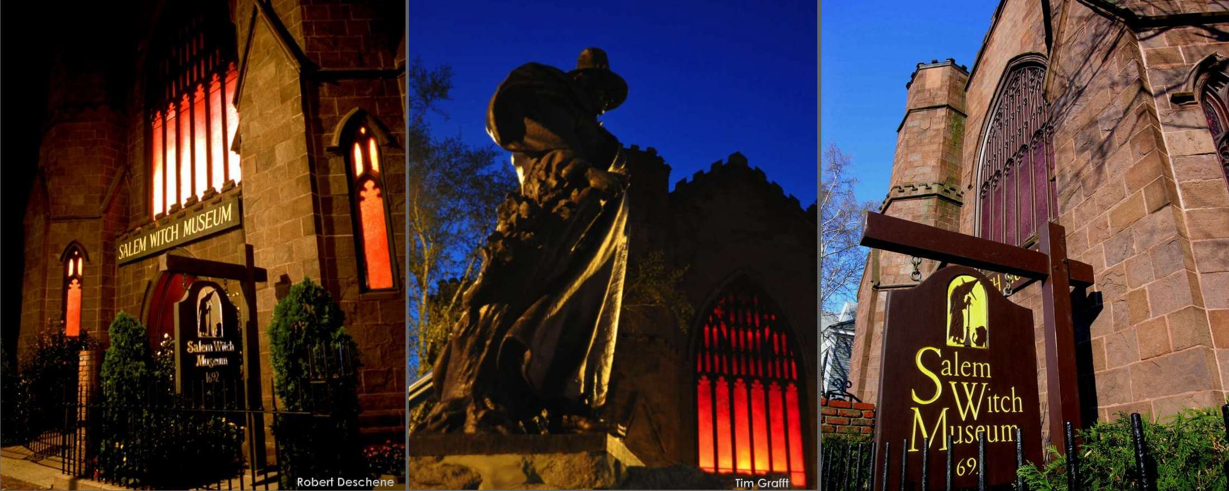
Witch Museum
Notes:
The Salem Witch Museum's presents the Salem Witch Trials of 1692, one of the most important and tragic events in American history.

Slide 26
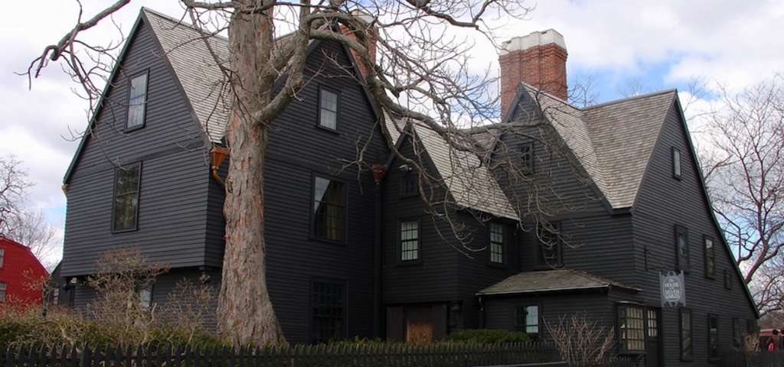
House of the Seven Gables
Notes:
In 1668, merchant and ship-owner John Turner built a house on Salem Harbor that was destined to become one of America's most beloved historic homes. It was made famous by American author Nathaniel Hawthorne's novel The House of the Seven Gables, named for its gables.

Slide 27
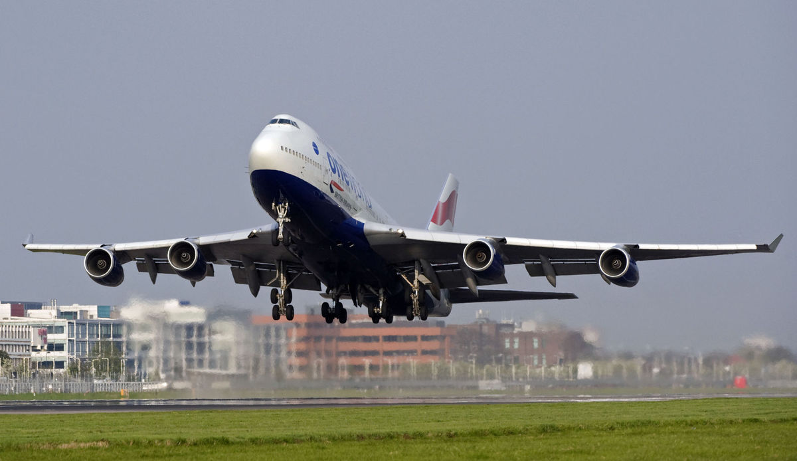
We return home!

